Slide 1
Principles OF SRE
Site RELIABILITY ENGINEERING

Slide 2
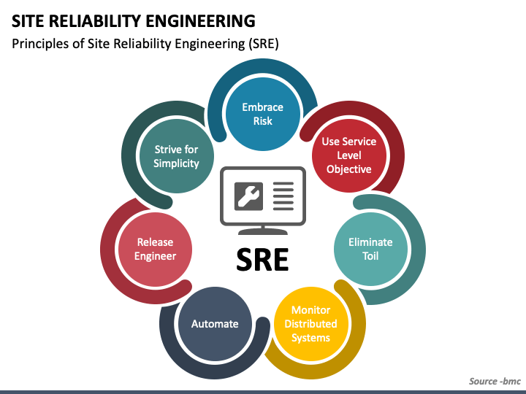

Slide 3
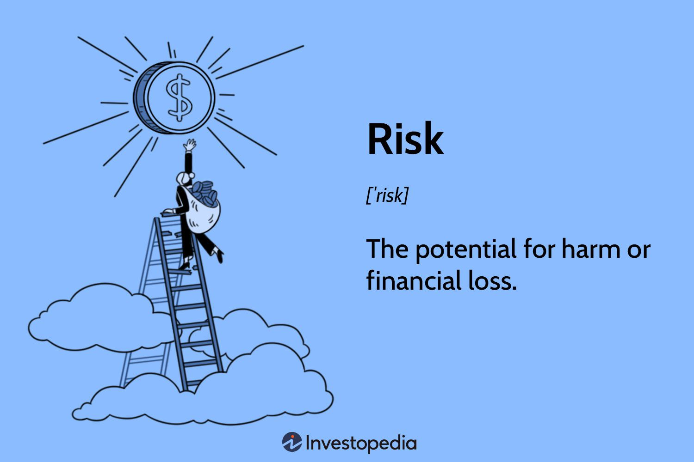
Risk
Risk is the possibility of something bad happening.
Risk involves uncertainty about the effects/implications of an activity with respect to something that humans value, often focusing on negative, undesirable consequences.

Slide 4
Embracing Risk
Embracing Risk
Managing Risk
Measuring Service Risk
Risk Tolerance of Services
Motivation for Error Budgets

Slide 5
SRE Principles
Difference between high reliability an extreme reliability in a service, ??
Extreme reliability comes at a cost: maximizing stability limits how fast new features can be developed and how quickly products can be delivered to users, and dramatically increases their cost, which in turn reduces the numbers of features a team can afford to offer.
Site Reliability Engineering seeks to balance the risk of unavailability with the goals of rapid innovation and efficient service operations,
so that users’ overall happiness—with features, service, and performance—is optimized.

Slide 6
Embrace Risk
In SRE, service reliability is managed largely by managing risk.
conceptualize risk as a continuum.
something that keeps on going, changing slowly over time
Giving equal importance to figuring out how to engineer greater reliability into Google systems and identifying the appropriate level of tolerance for the running services.

Slide 7
Embracing Risks
As teams build systems, cost does not increase linearly as reliability increments—an incremental improvement in reliability may cost 100x more than the previous increment. The costliness has two dimensions:
The cost of redundant machine/compute resources
The cost associated with redundant equipment that,
allows us to take systems offline for routine or unforeseen maintenance, or provides space for us to store parity code blocks that provide a minimum data durability guarantee.
The opportunity cost
the cost to an organization when engineering resources are allocated towards building systems or features that prioritize risk reduction rather than directly enhancing end-user experience.
Notes:
Storing Parity Code Blocks for Data Durability Guarantee: Parity code blocks are used in data storage systems, particularly in RAID (Redundant Array of Independent Disks) configurations, to provide data redundancy and fault tolerance. These parity blocks help in reconstructing data in case of disk failures. Storing parity code blocks requires additional storage space, which contributes to the overall cost of the system.

Slide 8
Managing Risk
Goal is to explicitly align the risk taken by a given service with the risk the business is willing to bear. strive to make a service reliable enough, but no more reliable than it needs to be.
Extreme availability produces diminishing returns as user experience becomes dominated by less reliable components like cellular networks or WiFi. While one want to reduce the risk of system failure, they also have to accept risk in order to deliver new products and features.

Slide 9
Measuring Service Risk
Identifying an objective metric to represent the property of a system want to optimize
Service failures can have many potential effects, including user dissatisfaction, harm, or loss of trust; direct or indirect revenue loss; brand or reputational impact; and undesirable press coverage.
To make this problem tractable and consistent across many types of systems, focus is on unplanned downtime

Slide 10

Time-based availability
For most services, the most straightforward way of representing risk tolerance is in terms of the acceptable level of unplanned downtime.
Unplanned downtime is captured by the desired level of service availability, usually expressed in terms of the number of "nines" we would like to provide: 99.9%, 99.99%, or 99.999% availability.
Each additional nine corresponds to an order of magnitude improvement toward 100% availability. For serving systems, this metric is traditionally calculated based on the proportion of system uptime (see Time-based availability).
Time-based availability

Slide 11
Example
For example, let’s say you’re trying to calculate the availability of a critical production asset. That asset ran for 200 hours in a single month. That asset also had two hours of unplanned downtime because of a breakdown, and eight hours of downtime for weekly PMs. That equals 10 hours of total downtime.
Here is how to calculate the availability of that asset:
Availability = 200 ÷ (200 + 10)
Availability = 200 ÷ 210
Availability = 0.952
Availability = 95.2%
Notes:
Weekly PMs: "PM" stands for preventive maintenance. Preventive maintenance involves performing routine inspections, servicing, and repairs on equipment to prevent breakdowns and prolong its operational life.

Slide 12
Time-based availability
Using this formula over the period of a year, we can calculate the acceptable number of minutes of downtime to reach a given number of nines of availability.
For example, a system with an availability target of 99.99% can be down for up to 52.56 minutes in a year and stay within its availability target

Slide 13

Availability %Availability %: This represents the target availability percentage of the system. For example, if the target availability is 99.99%, then the availability percentage would be 99.99.
365: This represents the number of days in a year.
24: This represents the number of hours in a day.
60: This represents the number of minutes in an hour.
Downtime (minutes/year)=(100−99.99)​/100×(365×24×60)
Downtime (minutes/year)=0.01/100×(365×24×60)
Downtime (minutes/year)=0.0001×365×24×60
Downtime (minutes/year)=52.56 minutes/year

Slide 14

Aggregate Availability
Instead of using metrics around uptime, Google define availability in terms of the request success rate
Aggregate availability shows how this yield-based metric is calculated over a rolling window (i.e., proportion of successful requests over a one-day window).
Aggregate availability
For example, a system that serves 2.5M requests in a day with a daily availability target of 99.99% can serve up to 250 errors and still hit its target for that given day.
Notes:
Quantifying unplanned downtime as a request success rate also makes this availability metric more amenable for use in systems that do not typically serve end users directly
measures the return on an investment over a period.

Slide 15
Total requests per day = 2.5 million
Availability target = 99.99% or 0.9999
Max Allowable Errors=2.5M×(1−0.9999)
Max Allowable Errors=2.5M×0.0001
Max Allowable Errors=2500,000×0.0001
Max Allowable Errors=250
Notes:
There are 6 zeroes in 1 million. 1 followed by six zeroes is 1,000,000.

Slide 16
Risk Tolerance of Services
What does it mean to identify the risk tolerance of a service?
In a formal environment or in the case of safety-critical systems, the risk tolerance of services is typically built directly into the basic product or service definition. At Google, services’ risk tolerance tends to be less clearly defined

Slide 17
Risk tolerance of services
There are many factors to consider when assessing the risk tolerance of services, such as the following:
What level of availability is required?
Do different types of failures have different effects on the service?
How can we use the service cost to help locate a service on the risk continuum?
What other service metrics are important to take into account?

Slide 18
Target level of availability
The target level of availability for a given Google service usually depends on the function it provides and how the service is positioned in the marketplace. The following list includes issues to consider:
What level of service will the users expect?
Does this service tie directly to revenue (either our revenue, or our customers’ revenue)?
Is this a paid service, or is it free?
If there are competitors in the marketplace, what level of service do those competitors provide?
Is this service targeted at consumers, or at enterprises?

Slide 19
Cost
Cost is often the key factor in determining the appropriate availability target for a service
In determining the availability target for each service, we ask questions such as:
If we were to build and operate these systems at one more nine of availability, what would our incremental increase in revenue be?
Does this additional revenue offset the cost of reaching that level of reliability?
To make this trade-off equation more concrete, consider the following cost/benefit for an example service where each request has equal value:
Proposed improvement in availability target: 99.9% → 99.99%
Proposed increase in availability: 0.09%
Service revenue: $1M
Value of improved availability: $1M * 0.0009 = $900
Notes:
There are 6 zeroes in 1 million. 1 followed by six zeroes is 1,000,000.
if the cost of the necessary infrastructure, technology, or operational changes to achieve this level of availability is less than the projected increase in revenue ($900 in this case), then it's considered a beneficial investment.
If the cost is greater than $900, the costs will exceed the projected increase in revenue

Slide 20
How to prioritize and communicate risks
The number of risks identified for each application varies greatly depending on the maturity of your application and team and target level for reliability or performance.
But whether we identify 5 risks or 50, two fundamental facts remain true:
Some risks are worse than others, and you have a finite amount of engineering time to address them.
You need a process to communicate the relative importance of the risks and to provide guidance on which risks should be addressed first

Slide 21
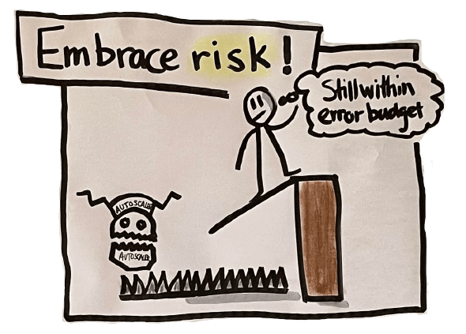
Error Budgets
An error budget is how much downtime a system can afford without upsetting customers,
or,
in other words, the margin of error permitted by a service level objective (SLO).

Slide 22
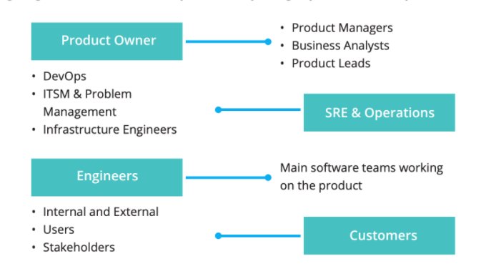
Why tech teams need and use error budgets?
Notes:
ITSM stands for Information Technology Service Management
The Problem Management team is a specific team within an organization responsible
for managing the lifecycle of problems identified within the IT infrastructure and services.
Internal user inside organization external outside organization

Slide 23
What is the purpose of an error budget?
Balance between releasing new features and maintaining an acceptable level of availability to customers.
An error budget tracks if a company is meeting contractual promises for a system or service and prevents it from pursuing too much innovation at the expense of that system or service’s reliability.
Eroor budget serves as a data point for deciding when to accelerate innovation or implement freezes.
When a company exceeds its error budget, SRE teams can pause innovation to eliminate persistent causes of errors from the system.
Notes:
the question is how do I balance the proper amounts of change and stability?

Slide 24
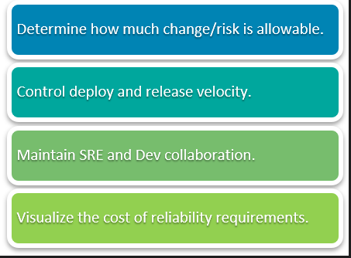
Error Budgets
Notes:
Error budgets are the prescriptive, quantitative measurements for how much risk a service is willing to tolerate.
Error budgets are the byproduct of the agreed-upon SLOs (Service Level Objectives) between product owners and systems engineers.
An error budget works in a similar way to a monetary budget.
A certain amount of errors or downtime is allocated to each service. As long as the number of errors or downtime of the service does not exceed the error budget, then the service is considered to be reliable enough.

Slide 25
DevOps principles
Risk and error budgets are directly related to many DevOps principles.
Error budgets clearly define that "accidents are normal" by quantifying accidents and risk.
Error budgets also enforce that "change should be gradual", because non-gradual changes could quickly break the SLO and prevent further development for the quarter.
This is why we say class SRE implements DevOps.

Slide 26
Error Budgets
Picking the right amount is critical. Even small changes to an error budget can have a significant effect.
Let's say that you wanted to ensure that a service was highly available and set the error budget at 0.01%. That would mean that your service could only be down for four and a half minutes per month.
Notes:
To calculate the maximum allowable downtime per month based on a specified error budget, you follow these steps:
Determine the Error Budget: The error budget is given as 0.01%, which means the allowed percentage of errors or downtime.
Convert Error Budget to a Decimal: Convert the error budget from a percentage to a decimal by dividing by 100. In this case, it's 0.01% or 0.0001 (0.01 / 100 = 0.0001).
Calculate Total Time in a Month: There are different ways to express a month in terms of minutes, but a common approach is to use 30 days and assume each day has 24 hours, each hour has 60 minutes: Total time in a month = 30 days * 24 hours per day * 60 minutes per hour
Calculate Maximum Allowable Downtime: Multiply the total time in a month by the error budget (as a decimal) to find the maximum allowable downtime: Maximum allowable downtime = Total time in a month * Error budget (as a decimal)
Let's do the calculations:
Total time in a month = 30 days * 24 hours/day * 60 minutes/hour = 43,200 minutes
Maximum allowable downtime = Total time in a month * Error budget = 43,200 minutes * 0.0001 = 4.32 minutes
So, the maximum allowable downtime per month, given the error budget of 0.01%, is approximately 4.32 minutes. This means the service can only be down for about 4.32 minutes in a month to meet the specified availability target. In the statement, it was rounded to four and a half minutes for simplicity.

Slide 27
Calculate Maximum Allowable Downtime: Total time in a month * Error budget (as a decimal)
Total time in a month = 30 days * 24 hours/day * 60 minutes/hour = 43,200 minutes
Error budget (as a decimal) =0.01% = 0.01 / 100 = 0.0001
Maximum Allowable Downtime: 43,200 minutes * 0.0001 = 4.32 minutes
Now with a budget the small, your team is going to be mostly focused on reliability, changes will be limited. One small problem could consume the entire budget. However, if you're willing to accept a larger 1% error budget, your service can now be down for up
Maximum Allowable Downtime: 43,200 minutes * 0.01 = 432 minutes =432/60 = 7.2 hours
This would allow for more frequent and riskier change.

Slide 28
Error budgets and SLO
Error budgets can be measured in relation to availability or uptime, both of which are defined by a company’s Service Level Objective (SLO). In other words, an error budget is 1 minus the SLO of the service. A 99.9% SLO service has a 0.1% error budget.
Error budgets and SLI
As part of operationalizing SLOs, SRE teams translate SLI percentages in terms of days and hours for software engineers.
Service-level indicators (SLIs) are the measures that indicate if an SLO is met or not. The SLI ranges from 0% to 100%, where 0% means nothing works, and 100% means nothing is broken.

Slide 29
Error budgets and SLA
Some downtime is inevitable, which is why Service-level agreements (SLA) should never promise 100% uptime. When an SLO is not met, the terms of a company’s SLA kick in.
Suppose a company has an SLA of 98% and an SLO of 99% availability. The error budget would be 1%, and that 1% in a 28-day window is 6.72 hours of downtime.
If the SLI dips below 99% during that 28-day window, then it’s used up all of its error budgets and is no longer meeting the SLO.
If availability is above the number promised by the SLA/SLO, an SRE team can release new features and take risks. But if it’s below the target, releases halt until the target numbers are back on track.

Slide 30
What are the components of error budgets?
Error Budgets first depend on establishing an SLO (Service Level Objective). SLOs are made up of an objective, a SLI (Service Level Indicator), and a timeframe.
Objective: The desired level of succcess, noted as a percentage
SLI: an evaluation used to distinguish number of failed events
Timeframe: enforcing a recency bias to the SLI
Here is an example of these elements:
Objective: 99.95%
SLI: 95 percentile latency of api requests over 5 mins is < 100ms
Timeframe: previous 28 days
Taken all together, the above example SLO would be: 99.95% of the 95th percentile latency of api requests over 5 mins is < 100ms over the previous 28 days
The Error Budget is then 1 - Objective of the SLO, in this case (1 - .9995 = .0005).
Using our 28 day timeframe, the "budget" for errors is 20.16 minutes (.0005 * (28 * 24 * 60))
Notes:
How recent--during a 5-minute period, 95% of the API requests had a latency (response time) of less than 100 milliseconds

Slide 31
Further Readings
https://sre.google/workbook/error-budget-policy/
https://cloud.google.com/blog/products/management-tools/sre-error-budgets-and-maintenance-windows
Book Chapter 2 Motivation for Error Budgets | Page 33 pdf Page 59

Slide 32
Risk Matrix
Each risk has many properties that can be used to evaluate its relative importance. In discussions internally and with customers, two properties in particular stand out as most relevant:
The likelihood of the risk occurring in a given time period.
The impact that would be felt if the risk materializes.
We began by defining three levels for each property, which are represented in the following 3x3 table.

Slide 33
Risk Matrix
Example table with representative risks for each category: The row headers represent likelihood and column headers represent impact.
 | Catastrophic | Damaging | Minimal
Frequent | Overload results in slow or dropped requests during the peak hour each day. | The wrong server is turned off and requests are dropped. | Restarts for weekly upgrades drop in-progress requests (i.e., no lame ducking).
Common | A bad release takes the entire service down. Rollback is not tested. | Users report an outage before monitoring and alerting notifies the operator. | A daylight savings bug drops requests.
Rare | There is a physical failure in the hosting location that requires complete restoration from a backup or disaster recovery plan. | Overload results in a cascading failure. Manual intervention is required to halt or fix the issue. | A leap year bug causes all servers to restart and drop requests.
Notes:
https://en.wikipedia.org/wiki/Risk_matrix

Slide 34
Take Notes
Our customers told us that the table of risks was a good overview and was easy to grasp. However, we struggled to explain the relative importance of entries in the list based on the cells in the table:
The distribution of risks across the cells was extremely uneven. Most risks ended up in the “common, damaging” cell, which doesn’t help to explain relative importance of the items within each cell.
Assigning a risk to a cell (and its subsequent position in the list of risks) is subjective and depends on the reliability target of the application. For example, the “frequent, catastrophic” example of dropping traffic for a few minutes during a release is catastrophic at four nines, but less so at two nines.
Ordering the cells into a ranking is not straightforward. Is it more important to handle a “rare, catastrophic” risk, or a “frequent, minimal” risk? The answer is not clear from the names or definitions of the categories alone. Further, the desired order can change from matrix to matrix depending on the number of items in each cell.

Slide 35
Risk Management
SO WHAT TO DO THAN??

Slide 36
Risk Assessment Field :Expected Loss
Another useful model: using impact and likelihood to calculate the expected loss from a risk.
Expressed as a numeric quantity, this expected loss value is great way to explain the relative importance of our list of risks.
How do we convert qualitative concepts of impact and likelihood to quantified values that we can use to calculate expected loss?
Notes:
METRICS

Slide 37
Expected Losses
the concepts of Mean Time Between Failure (MTBF), Mean Time To Recover (MTTR), and error budget.
The MTBF of a risk provides a measure of likelihood (i.e., how long it takes for the risk to cause a failure),
the MTTR provides a measure of impact (i.e., how long we expect the failure to last before recovering),
and the error budget is the expected number of downtime minutes per year that you're willing to allow (a.k.a. accepted loss).

Slide 38
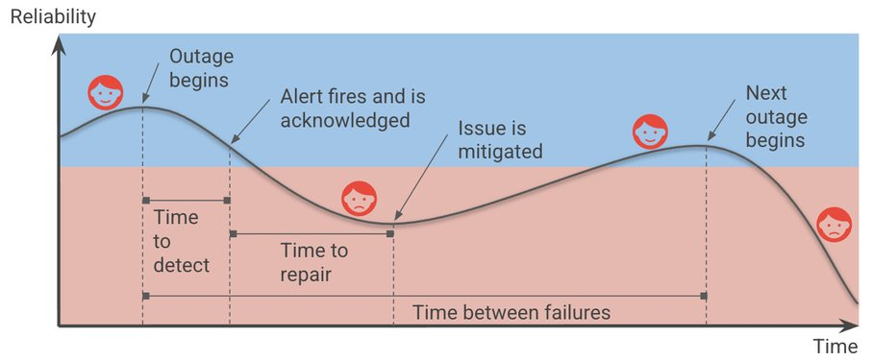
Notes:
we can improve reliability by increasing the time between failures, decreasing the time-to-detect or time-to-repair, and of course, reducing the impact of the outages in the first place

Slide 39
Expected Loss-How?
Experience and judgement to estimate each risk’s MTBF (counted in days) and the subsequent MTTR (counted in minutes out of SLO).
Using these two values, the expected loss in minutes for each risk is estimated over a fixed period of time, and generate the desired ranking.
Mean Time Between Failures (MTBF): total uptime / # of failures. This is the average time between failures.
Mean Time to Repair (MTTR): total downtime / # of failures. This is the average time taken to recover from a failure.

Slide 40
Risk Ranking
Calculating expected losses over a year is a is useful timeframe for risk-ranking, and developed a three-color traffic light system to provide high-level guidance and quick visual feedback on the magnitude of each risk vs. the error budget:
Red: This risk is unacceptable, as it falls above the acceptable error budget for a single risk (we typically use 25%), and therefore, can have a major impact on your reliability in a single event.
Amber: This risk should not be acceptable, as it’s a major consumer of your error budget and therefore, needs to be addressed. You may be able to accept some amber risks by addressing some less urgent (green) risks to buy back budget.
Green: This is an acceptable risk. It's not a major consumer of your error budget, and in aggregate, does not cause your application to exceed the error budget. You don't have to address green risks, but may wish to do so to give yourself more budget to cover unexpected risks, or to accept amber risks that are hard to mitigate or eliminate.

Slide 41
Three-color traffic light system
Based on the three-color traffic light system, the following table demonstrates how we rank and color the risks given a 3-nines availability target. The risks are a combination of those in the original matrix and some additional examples to help illustrate the amber category.

Slide 42
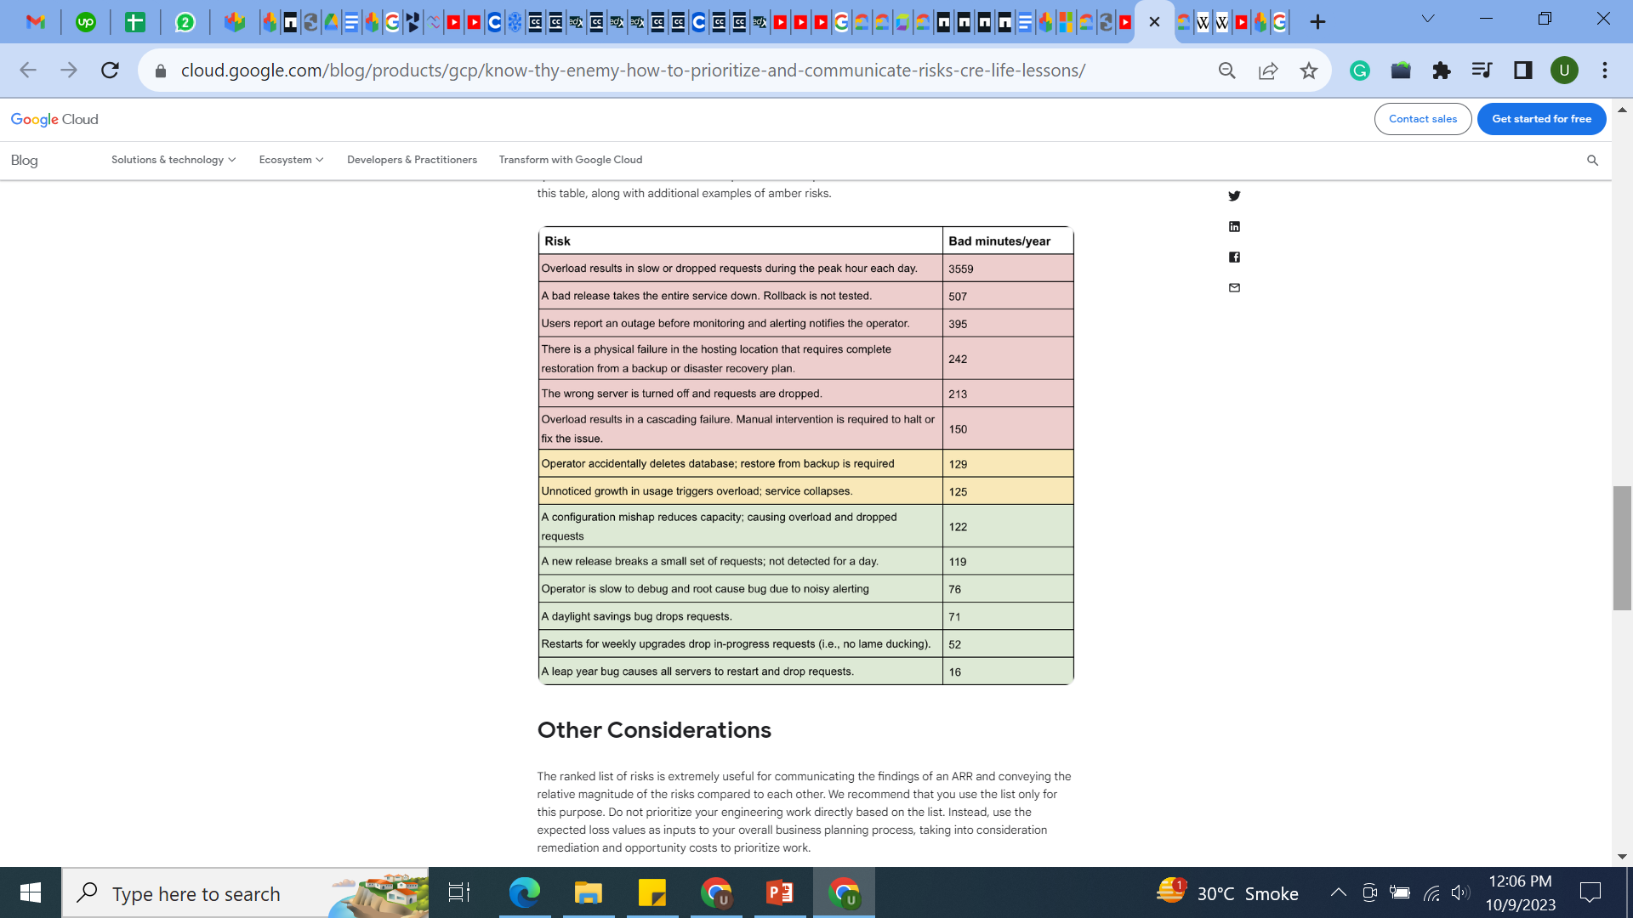
Notes:
https://docs.google.com/spreadsheets/d/1XTsPG79XCCiaOEMj8K4mgPg39ZWB1l5fzDc1aDjLW2Y/view#gid=847168250

Slide 43
MTTD and MTTR
To introduce additional granularity into the calculation of MTBF and MTTR values, for more accurate estimates. First, we split MTTR into two components:
Mean Time To Detect (MTTD): The time between when the risk first manifests and when the issue is brought to the attention of someone (or something) capable of remediating it.
Mean Time To Repair (MTTR): Redefined to mean the time between when the issue is brought to the attention of someone capable of remediating it and when it is actually remediated.
This granularity is driven by the realization that, often, the time to notice an issue and the time to fix it differ significantly. It’s easier to assess and ensure estimates are consistent across risks with these figures separately specified.

Slide 44
Annual Expected Loss
(MTTD + MTTR) * (365.25 / MTBF) * percent of affected users

Slide 45
Example
These metrics can be computed historically (e.g., over the past 3 months, or year) and combined as
(Total Period / MTBF) * MTTR to give an expected downtime value.
Continuing with the above example, if the historical MTBF is calculated to be 10 days, and the historical MTTR is calculated to be 20 minutes, then you would expect to see 60 minutes of downtime
((30 days / 10 days) * 20 minutes)
clearly outside the 44-minute error budget for a three-nines availability target.
To meet the target would require decreasing the MTBF (say to every 20 days) or decreasing the MTTR (say to 10 minutes), or a combination of both.

Slide 46
Risk Analysis Assignment 1
C:\Users\Dell\Downloads\CRE Risk Analysis Template - Public.xlsx
Resources:
https://cloud.google.com/blog/products/devops-sre/how-sres-analyze-risks-to-evaluate-slos
Scenario: Take any Google's service such as email, drive etc. carry out risk analysis and fill in the template provided calculate downtime and assess whether they meet the error budget or not.

